Slide 1
Ruyan ZHOU
La variabilité du sommeil et ses effets sur les maladies cardiométaboliques

Slide 2
Background and Theory
1. Modern lifestyle
2.Circadian rhythm dysregulation theory
3.Chronic inflammatory activation theory
→ Inflammatory Factors, BMI,Diabetes,Hypertension,Dyslipidemia,Cardiometabolic
4. Single-dimension sleep metrics and diseases
5. Single-dimension approach VS Existing Research
6. Limited research methods
↓ More rigorous and multi-dimensional approaches for sleep research
(Diverse Sleep Metrics, Two different algorithnms, Comprehensive Exploration of Diseases,Cross-prospective study ,

Slide 3

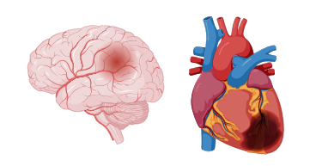
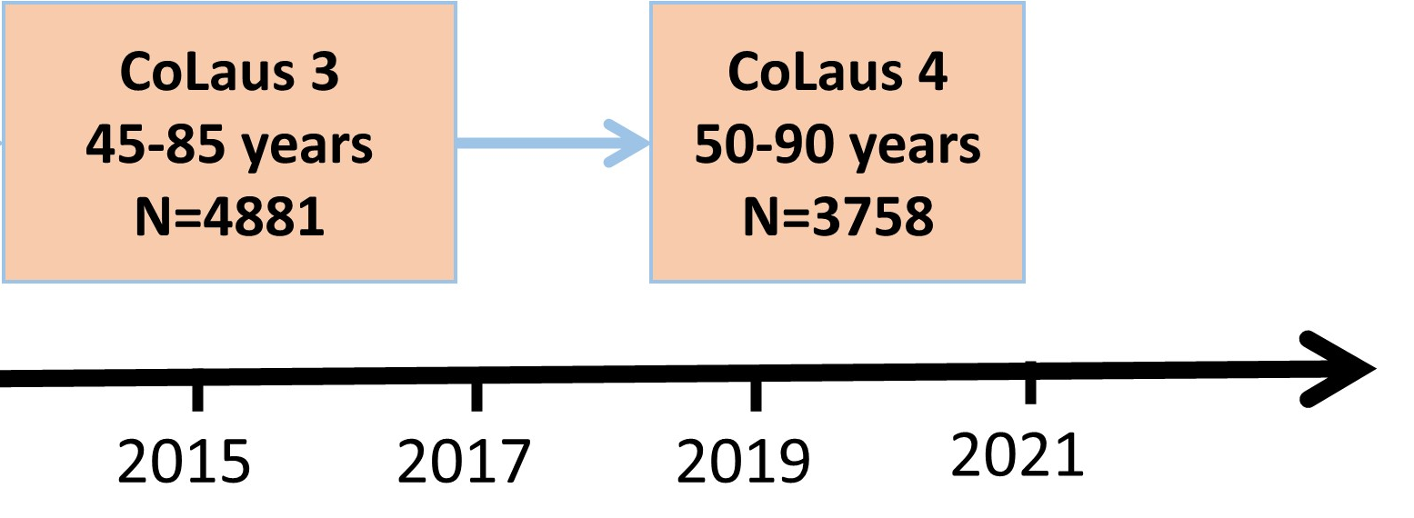



Méthodologie
AVC
Infarctus
CoLaus 5
55-95 years
N>1500
2025
Dyslipémie
Hypertension
Diabète

