Slide 1

Sex-based difference in functional performance and quality of life 1 year after supervised exercise training in patients with symptomatic peripheral artery disease
Stefano Lanzi, Anina Pousaz, Luca Calanca, Lucia Mazzolai
Division of Angiology
Heart and Vessel Department
Lausanne University Hospital, Switzerland

Slide 2
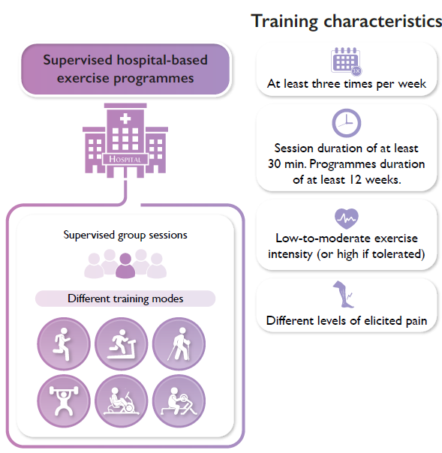


Introduction – PAD and exercise training
Long-term benefits?
Functional performance
Quality of life
Self-perceived walking ability
Sex-based difference?
Mazzolai et al., Eur Heart J. 2024 Aug 30:ehae179; Mazzolai et al., Eur Heart J. 2024 Apr 14;45(15):1303-1321

Slide 3
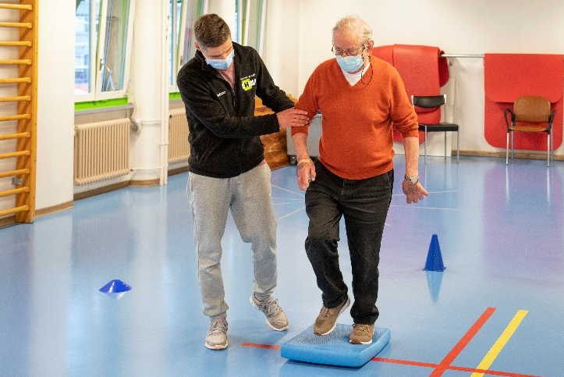
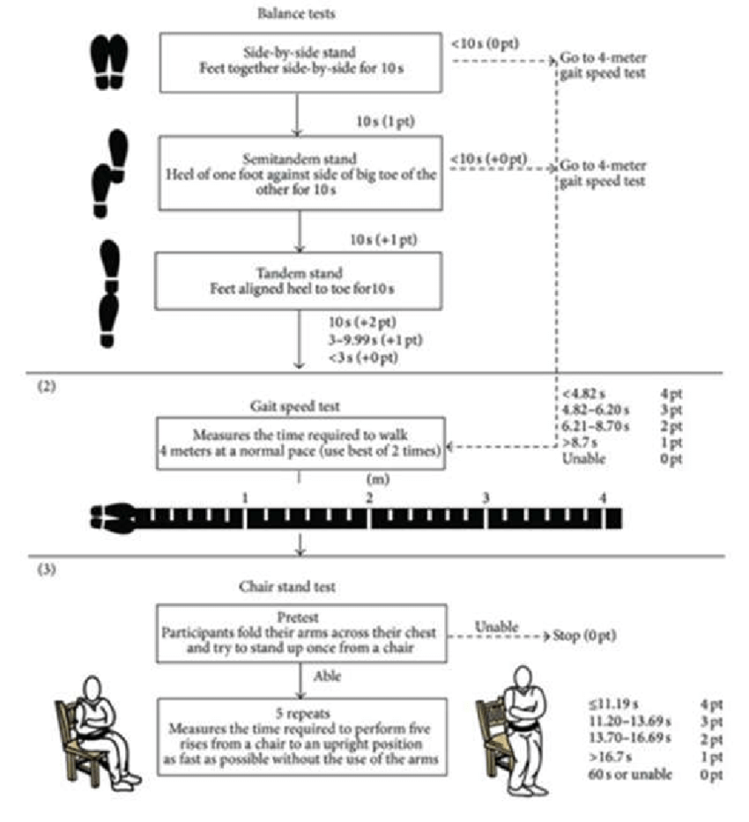




Methods
90 patients (women = 30, men = 60) with symptomatic PAD
3 months, 3x/week
1x/week functional lower limb strengthening
2x/wk Nordic walking
Pre-program assessments
Post-program assessments
6 months follow-up assessments
12 months follow-up assessments
Quality of life and walking ability
Vascular assessment
6-min walk test
Stair climb test
SPPB battery test

Slide 4
Results – functional performance (by sex)
The improvements in functional performance observed following the 3-month multimodal SET program were similarly maintained over a 12-month period in both women and men.

Slide 5
Results – Quality of life and walking ability
Quality of life and walking ability were found to be improved over a 12-month period in women only

Slide 6
Thank you ☺
Stefano Lanzi, Anina Pousaz, Luca Calanca, Lucia Mazzolai
Division of Angiology
Heart and Vessel Department
Lausanne University Hospital, Switzerland

